Slide 1
Data analysis and visualization (CS306)
Instructor: Manish Narwaria

Slide 2
Hypothesis testing
ingredients:
claim/hypothesis
null and alternate hypothesis
sampling distribution
significance level

Slide 3
Hypothesis testing
significance test for mean
student t-test
F-test
ANOVA
confidence intervals

Slide 4
Hypothesis testing
one of most fundamental theorems of probability
roughly, CLT states that the sampling distribution of the arithmetic mean (and sum) will approach a normal distribution as the sample size increases, regardless of the underlying population distribution

Slide 5
Hypothesis testing
let X be a random sample drawn from having an arbitrary population, then the sampling distribution of the mean of X will follow normal distribution as sample size n increases i.e.
population parameters

Slide 6
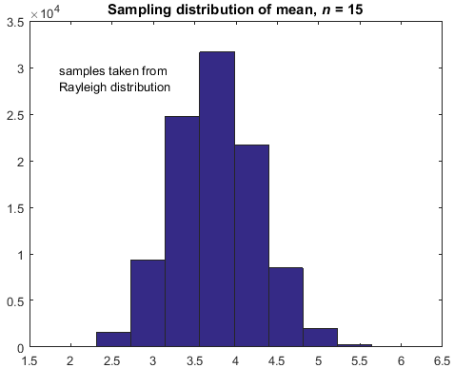
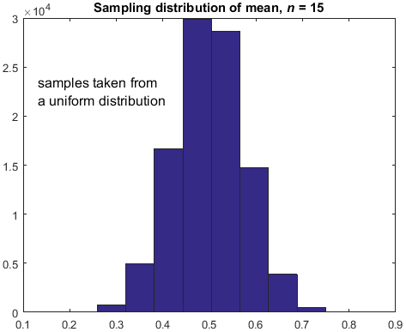
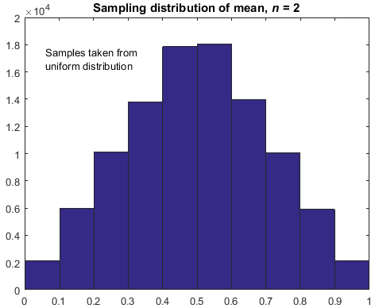
Hypothesis testing
in practice, the sample size n need not be too large to justify approximate normality of the sampling distribution

Slide 7
Hypothesis testing
two sample t-test
two sample independent t-test

Slide 8
Hypothesis testing
can we use the above as a test statistic to construct sampling distribution of difference of two means?

Slide 9
Hypothesis testing
t-distribution --> a case of ratio distribution
ratio of normally and a chi-squared distributed variables
denominator also becomes a random variable

Slide 10
Hypothesis testing
two sample independent t-test
difference between
sample means
pooled standard deviation
important: assumes that variances of the two samples are similar

Slide 11
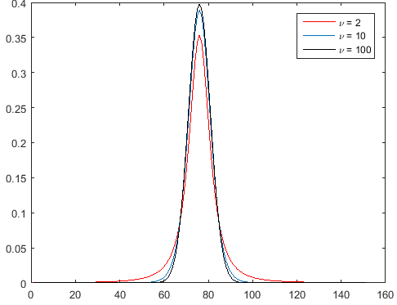
Hypothesis testing
the t-distribution
heavier tails --> result of
less number of samples
approaches normal distribution
as sample size increases
two tails

Slide 12
Hypothesis testing
two-tailed and one-tailed tests
how extreme the test statistic is as compared to other values in an assumed distribution
but extreme values can be both on higher and lower sides (eg. normal distribution)

Slide 13
Hypothesis testing
two-tailed test
applicable when there are two tails (possibly symmetric)
area = α/2, on either ends of the distribution

Slide 14
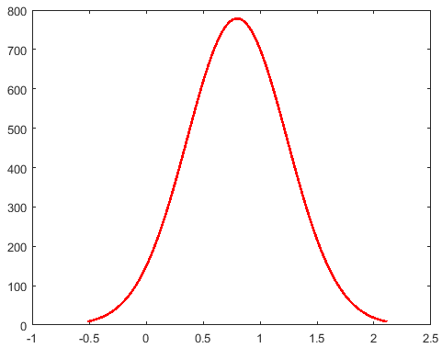
Hypothesis testing
area = α/2

Slide 15
Hypothesis testing
two-tailed test
Eg. for testing data normality
test statistic should locate itself in the ‘acceptable’ area of the assumed curve

Slide 16
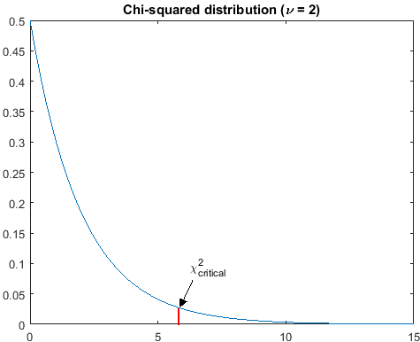
Hypothesis testing
one-tailed tests
important to specify the
direction of the test (left or right)

Slide 17
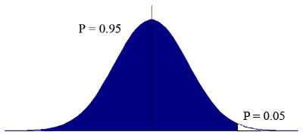
Hypothesis testing
one-tailed tests
important to specify the
direction of the test (left or right)

Slide 18
Hypothesis testing
an instructor wants to evaluate if extra classes have a positive impact on the student performance which is measured in terms of marks obtained in a test out of 100. The data is given below:
 | without extra classes | with extra classes
mean | 82.3 | 86.8
standard deviation | 7.1 | 7.4
sample size | 21 | 23

Slide 19
Hypothesis testing
given the following data, establish if a new medicine results in same levels of lowered blood pressure, as compared to an old medicine.
effect of sample size 144 vs 16
 | old | new
mean | 130 | 123.5
standard deviation | 12.6 | 13.5
sample size | 144 | 16

Slide 20
Hypothesis testing
in the example of medicine (for lowering blood pressure levels), is it a good idea to use independent samples (and hence a two sample independent t-test)?
probably no
different sample sizes --> generally not an issue
the effect of medicine can be different on different individuals (affected by weight and other health parameters)

Slide 21
Hypothesis testing
two sample t-test
two sample dependent t-test --> paired t-tests
when the samples are dependent due to the way they have been obtained (eg. effect of treatment, before and after analysis)

Slide 22
Hypothesis testing
how to decide between paired t-test vs unpaired t-test?
obvious in some cases
weight loss program
effectiveness of medicine
evaluating wear of tires
only one factor is different in the two samples

Slide 23
Hypothesis testing
difference vector takes into account the one-to-one correspondence between sample values
notice the dependence on sample size

Slide 24
Hypothesis testing
the SNR interpretation of t-statistic
t-statistic is useful only in relative sense (by itself it does not convey any useful information)
standard error SEM

Slide 25
Hypothesis testing
assumptions in two sample t-tests
for independent t-test (also called unpaired t-test)
the two samples should be independent (needs to analyzed carefully depending on the problem)
the variances are equal (at least similar: not more than twice of the other)

Slide 26
Hypothesis testing
assumptions in two sample t-tests
for paired t-test
there is a one-to-one correspondence between sample values
difference vector should keep the order of the values in the two samples

Slide 27
Hypothesis testing
assumptions in two sample t-tests
what about the sample size?
n ↑,SE↓⇒ t↑(a shift to right or left extreme)
bigger sample size can lead to more extreme test statistic values

Slide 28
Hypothesis testing
assumptions in two sample t-tests
what about the sample size?
a study with more than 22000 subjects (for over 5 years) concluded with statistical significance that aspirin prevented a cardiovascular problem.

Slide 29
Hypothesis testing
assumptions in two sample t-tests
what about the sample size?
so a bigger sample size is always better
X

Slide 30
Hypothesis testing
effect size is also important
quantify if the observed difference in means large enough

Slide 31
Hypothesis testing
a 25 kg. difference in weights (designing an elevator vs cargo vessel manufacturing)
a 2.4 degree Celsius difference (microbial culture vs environment for a using a computer)
remember: a t-test cannot be used to establish if the observed mean difference is significant or not

Slide 32
Hypothesis testing
first, ask the expert if the difference is practically useful (eg. is MOS difference of 0.5 high enough)
then, use a t-test to quantify the likelihood that the observed difference (if deemed high enough by an expert) is not by chance
if the observed difference is not practically relevant, there is no need for a t-test

Slide 33
Hypothesis testing
what do ‘insignificant’ results may imply?
the difference between means is actually not significant
SE is higher (less agreement within the sample) --> t-statistic is pulled towards the center
sample size is insufficient
practically relevant
issue of data collection
is paired design better than an independent one?

Slide 34
Hypothesis testing
what do ‘significant’ results imply?
is sample size the driving factor?
actual effect may be practically irrelevant
statistically significant ≠ rejecting the null hypothesis

Slide 35
Hypothesis testing
assumptions in two sample t-tests
what about the sample size?
remember: t-distribution specifically caters to smaller number of samples (by allowing more values in the tails) --> controlled through df (normal distribution does not have any df or df = ∞)
t_{critical} is adjusted to sample size (for smaller sample it is high --> need higher difference for statistical significance)

Slide 36
Hypothesis testing
assumptions in two sample t-tests
what about the sample size?
quantity quality
either no effect on statistical inference
(eg. observers increased from 26 to 50)
or
worse, leads to statistically significant
difference (eg. no. of observers = 250)
focus on quantifying the effect
(difference of means) unbiasedly
eg. video content selection
don’t first make a conclusion and then
collect the data!

Slide 37
Hypothesis testing
a typical question for data analyst
is the selected sample size sufficient for my study?
ans: it should depend on the expected variability or number of factors that directly affect the outcome of the experiment (eg. gender, weight, health, culture…)
for video quality, these factors generally do not matter

Slide 38
Hypothesis testing
a researcher claims that his/her algorithm A does a better job at detecting faces in an image, compared to a competing method B. As a data analyst, how will you support/weaken this claim, assuming the following data?
% accuracy | A | B
mean | 86.4 | 85.9
standard deviation | 16.9 | 11.3
sample size | 120 | 120

Slide 39
Hypothesis testing
remember: any statistical test (including t-test) is essentially GIGO
in previous example, you can still do the t-test and draw statistical conclusions
but they might not be meaningful if the test images are different

Slide 40
Hypothesis testing
practically useful differences (effect size) are the key (always rely on observed data rather than inferential process)
never manipulate by increasing sample size in an arbitrary manner
think in terms of SNR interpretation (allows a focus on quality of sampling)
eliminate ‘other factors’ to maximum possible extent

Slide 41
Hypothesis testing
assumptions in two sample t-tests
should the two samples be normally distributed?
requirement of sample normality is often quoted in many textbooks as an assumption for validity of a t-test
run a test for normality and see if the null
hypothesis can be accepted or rejected

Slide 42
Hypothesis testing
should the two samples be normally distributed?
recall that t-statistic is assumed to follow a t-distribution --> ratio distribution (ratio of variables from the normal distribution and the square-root of chi-squared distribution)
the numerator (difference between means) should follow normal distribution, not the two samples

Slide 43
Hypothesis testing
assumptions in two sample t-tests
should the two samples be normally distributed?
No, the sampling distribution of the difference in means must be normal or at least approximately normal

Slide 44
Hypothesis testing
assumptions in parametric tests
z or t-test, F-test, anova…
should the two samples be normally distributed?
No, the sampling distribution of the difference in means must be normal or at least approximately normal

Slide 45
Hypothesis testing
the sampling distribution of the difference in means must be normal or at least approximately normal
how will we check that?
can we apply normality tests?

Slide 46
Hypothesis testing
sampling distribution
of mean of first sample
sampling distribution
of mean of second sample
by extension, the CLT can be used to justify the assumption of approximate normality for the sampling distribution of the difference in means
Key point:
sum or difference of two normally
distributed variables is also normal

Slide 47
Hypothesis testing
CLT justifies statistical analysis such as t-test (and several other parametric tests) even if the sample (or population) is not normal (as sample normality is not required)
CLT is one of the main reasons why statistical tests can be carried out irrespective of the underlying population and/or sample distributions

Slide 48
Hypothesis testing
remember: CLT deals with and addresses only arithmetic mean (or sum) and its sampling distribution
sampling distribution of any other higher order test statistic may or may not be normally distributed
CLT is still useful as mean/average are often used to draw inferences about a population from given sample(s)

Slide 49
Hypothesis testing
CLT is still useful as mean/average are often used to draw inferences about a population from given sample(s)
remember: CLT only provides a theoretical result that helps to satisfy the required mathematical assumptions of normality of sampling distribution, it does not in any way overcome the practical limitations of the t-test or any other parametric test (always remember GIGO)

Slide 50
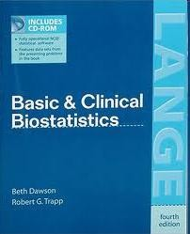
Hypothesis testing
observations in each group follow a normal distribution.‖
…
Image courtesy: Bruce Weaver

Slide 51

Hypothesis testing
Normally distributed data: it is assumed hat the data are from a normally distributed population
…
First Edition (2000)
Image courtesy: Bruce Weaver

Slide 52
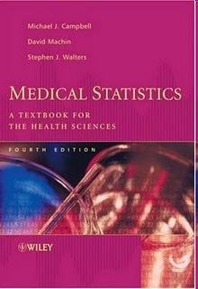
Hypothesis testing
The data is Normally distributed in both groups.
…
First Edition (2000)
Image courtesy: Bruce Weaver

Slide 53
Hypothesis testing
should the two samples be normally distributed?
are the textbooks incorrect?
are normality tests not useful?

Slide 54
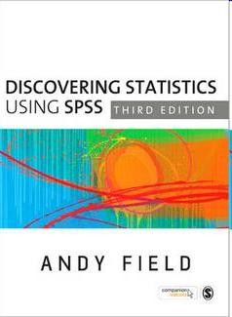
Hypothesis testing
Requirement of normality testing has been removed
Third Edition (2009)
Image courtesy: Bruce Weaver

Slide 55
Confidence intervals
another type of inferential statistic
multi-valued estimate (unlike a point estimate) of a population parameter (eg. mean, standard deviation, correlation coefficient…)
defines an interval of plausible values of a parameter
related to hypothesis testing

Slide 56
Confidence intervals
CLT can be applied if the population parameter under consideration is the sample mean
to construct the CI for a population with mean and standard deviation

Slide 57
Confidence intervals

Slide 58
Confidence intervals
95% CI

Slide 59
Confidence intervals
in practice, population variance is unknown

Slide 60
Confidence intervals
CI can also be determined for difference in means

Slide 61
Confidence intervals
interpretation of a CI
what the meaning of 95% CI?

Slide 62
Confidence intervals
inferring statistical significance from CI for comparing population parameters
observe if the two CIs overlap

Slide 63
Confidence intervals
compute the upper and lower bounds for the two sample means separately
if the two CIs do not overlap then,

Slide 64
Confidence intervals
CI and hypothesis testing are related
values within CI are plausible for the population parameter under consideration (those outside can be seen as outliers)
if the value of the parameter specified by the null hypothesis is contained in the CI then the null hypothesis cannot be rejected

Slide 65
Confidence intervals
CI and hypothesis testing are related
case of one sample t-test (null hypothesis is that the sample mean is equal to some constant)
if the CI for the sample mean contains that constant, then null hypothesis cannot be rejected

Slide 66
Confidence intervals
CI and hypothesis testing are related
case of two sample t-test (null hypothesis is that the difference of means is zero)
if the CI for the difference of means contains zero, then null hypothesis cannot be rejected

Slide 67
Confidence intervals
compute the CIs for the sample means
no overlap --> the difference in means is statistically significant (will agree with t-test)
overlap --> the difference in means may or may not be statistically significant (t-test may or may not agree)

Slide 68
Confidence intervals
not significant
significant
CI overlap
no CI overlap

Slide 69
Confidence intervals
compute the CIs for the sample means
overlap --> the difference in means may or may not be statistically significant (t-test may or may not agree)
which result is correct: CI or t-test based?

Slide 70
Confidence intervals
CI and t-test are both inferential statistics
CI provides a visual illustration of plausible values of the population parameter
more interpretable but…

Slide 71
Confidence intervals
misusing confidence intervals with confidence
there is 95% chance of finding the true mean within CI
probability that the true mean is greater/lesser than lower/upper bound is p%

Slide 72
Confidence intervals
an instructor wants to know the mean CPI of students at DAIICT. Previous survey showed mean = 6.78 and standard deviation = 1.35.
how many students should be sampled for a 95% confidence interval to have margin of error 0.2?

Slide 73
Confidence intervals
correlation: the degree to which two variables co-vary
quantifying the linear relationship of two variables
Pearson linear correlation coefficient: a popular measure of the intensity of linear association

Slide 74
Confidence intervals

Slide 75
Confidence intervals
scatter plot and correlation coefficient
2D plot with the two variables being the axes
data points will lie in a straight line if the correlation coefficient is high; otherwise scattered in the 2D space

Slide 76
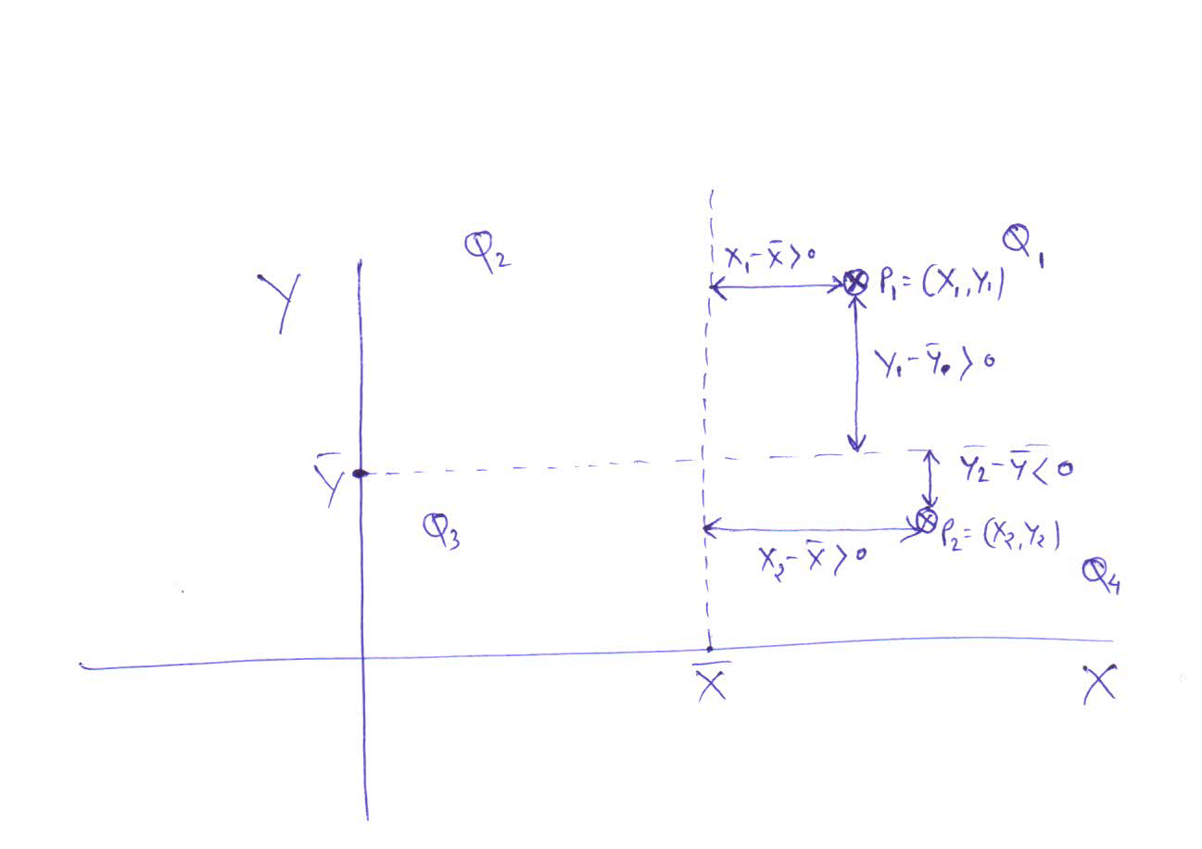
Confidence intervals
squared deviations from mean; always positive

Slide 77
Confidence intervals
CI for correlation coefficient
why do we need to compute CI for r?
like mean, r is a descriptive statistic (widely used to quantify the degree of relationship in statistics, video processing, machine learning, social sciences, life sciences…)

Slide 78
Confidence intervals
r can also be used to measure the effect size for statistical tests
higher r implies more similarity --> difference of means is more likely to be practically not useful

Slide 79
Confidence intervals
CI for correlation coefficient
why do we need to compute CI for r?
descriptive --> inferential

Slide 80
Confidence intervals
CI for correlation coefficient
can we use the formulae for CI of mean to compute the CI for correlation coefficient?
yes if sampling distribution of r follows normal distribution

Slide 81
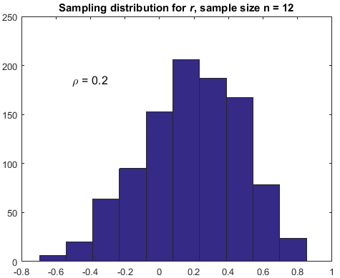
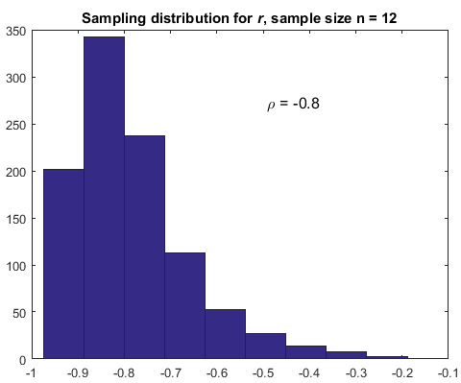
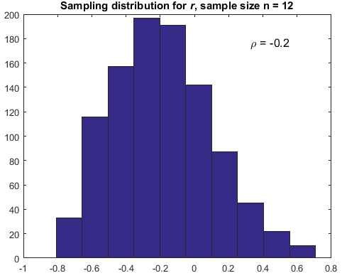
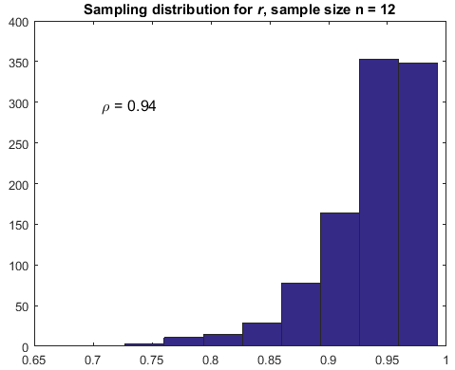
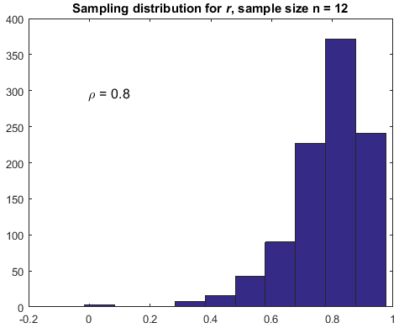
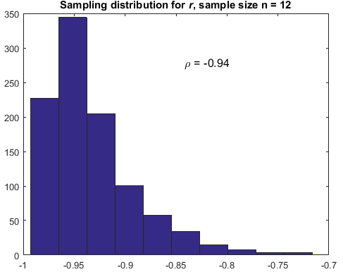
Confidence intervals
why is the sampling distribution skewed when the population correlation is increased?

Slide 82
Confidence intervals
CI for correlation coefficient
can we use the formulae for CI of mean to compute the CI for correlation coefficient?
no (sampling distribution of r is skewed especially when the correlation between the two population is higher)

Slide 83
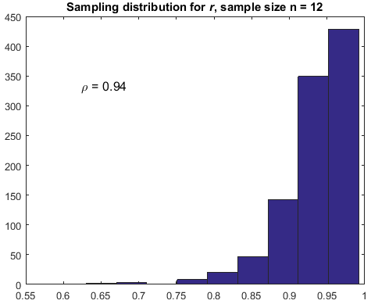
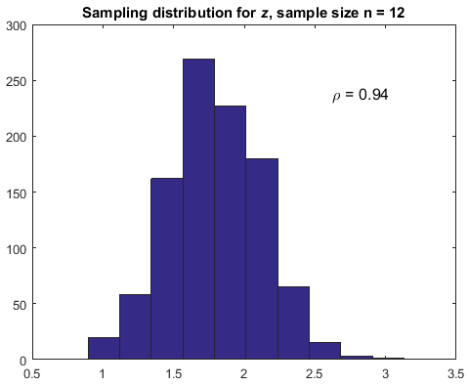
Confidence intervals
why is this useful?

Slide 84
Confidence intervals

Slide 85
Confidence intervals
CI for difference between two correlation coefficients
observe if 0 is included
in this interval

Slide 86
Confidence intervals
why CI is widely used especially for correlation coefficients?
CI typically provide more information (range of values) about a single sample mean or sample correlation --> more interpretable in case of correlation coefficient
t-tests are useful to compare two means

Slide 87
Confidence intervals
The operations manager of a large production plant would like to estimate the mean amount of time a worker takes to assemble a new electronic component. Assume that the standard deviation of this assembly time is 3.6 minutes.
after observing 120 workers assembling similar devices, the manager noticed that their average time was 16.2 minutes. Construct a 92% confidence interval for the mean assembly time.
how many workers should be involved in this study in order to have the mean assembly time estimated up to ±15 seconds with 92% confidence?

Slide 88
Confidence intervals
suppose the mean CPI value for a sample of 100 randomly selected students is 7.01 with some standard deviation. Can we construct a 100% CI for this data?

Slide 89
Confidence intervals
we collect data about marks obtained and the time spent in examination hall for a sample of 100 students. The correlation between the two variables is 0.08. Can we conclude that there is a no relation between marks obtained and the time spent in exam hall?

Slide 90
Confidence intervals
correlation coefficient:
does not imply causation
quantifies only the linear association

Slide 91
Confidence intervals
CI depends on the standard error (SE)
increasing the sample size will decrease the CI
is a small CI better than a bigger one?
what should be sample size so that margin of error is less than 5%, with a 95% confidence?

Slide 92
Hypothesis testing
like mean difference, analyzing sample variances is also practically useful
CPI variance --> is it 0.1 or 1.1?
length of gear parts, requirement --> mean but due to imperfection machine can have variation

Slide 93
Hypothesis testing
like mean difference, analyzing sample variances is also practically useful
courier delivery times --> is mean delivery time enough?
average temperature of a place
useful in anova

Slide 94
Hypothesis testing
testing for single variance (eg. checking the variation of concentration of a chemical in waste water treatment plant)

Slide 95
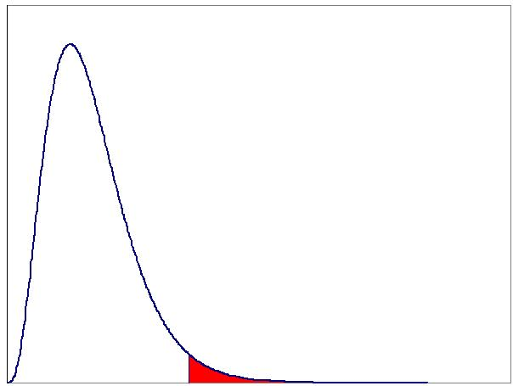
Hypothesis testing
assuming the null hypothesis to be true, will follow a chi-squared distribution with df = n-1

Slide 96
Hypothesis testing
F-test for comparing variances
F statistic is the ratio of sample variances, follows F distribution
numerator and denominator can have different degrees of freedom

Slide 97
Hypothesis testing
why can we not define different test statistics in a similar manner?

Slide 98
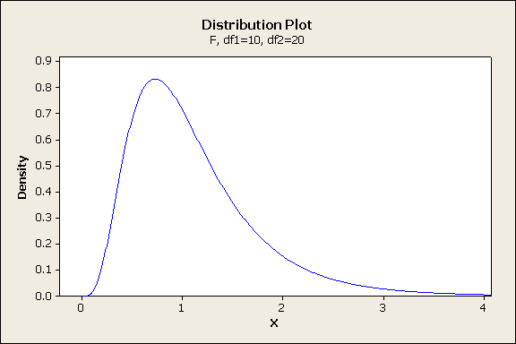
Hypothesis testing
F-distribution is formed by ratio of two independent chi-square distributed variables

Slide 99
Hypothesis testing
locate the F-statistic on the F-distribution
F = 1 when sample variances are equal
by convention, we use the smaller sample variance in denominator --> F ≥ 1

Slide 100
Hypothesis testing
population variance

Slide 101
Hypothesis testing
obtain ratio of sample variances s₁²/s₂² = (s₁/s₂)²
choose α, and obtain:
F_{L} = F_{1−α/2, n2-1, n1-1}
F_{U} = F_{α/2, n2-1, n1-1}
Confidence Interval (CI):
what should be the condition for statistical insignificance?

Slide 102
Hypothesis testing
why is F-test important?
applications (eg. wear and tear in production, financial time series, exchange rates…)
used in ANOVA (analysis of variance)
useful in residual analysis, why?

Slide 103
Hypothesis testing
case study 1: comparing residuals in video quality measurement
error analysis --> t-test is not meaningful
F-statistic is the ratio of variances of residuals from two methods A and B
df = no. of data points - 1

Slide 104
Hypothesis testing
case study 2: comparing residuals in regression analysis

Slide 105
Hypothesis testing
time | No. of bacteria (x10³)
2.5 | 10.07
2.8 | 11.07
5.4 | 14.59
6.5 | 20.70
9.2 | 27.94
9.5 | 31.50
11.0 | 38.04
13.3 | 49.90
14.6 | 60.72
16.4 | 75.57
analysis:
which model provides a better fit?
which model is better at explaining the observed data?
prediction:
which model could be used to make future predictions?

Slide 106
Hypothesis testing
comparing residuals from two models using F-test
same number of parameters in the two models
df = no. of data points – number of fitted parameters

Slide 107
Hypothesis testing
comparing residuals from two models using F-test
different number of parameters in the two models --> simpler model has lower number
to compare a simple model with a more complex one

Slide 108
Hypothesis testing
residual or error analysis --> notion of ‘paired’ F-test
is complex model always better than simpler one?
overfitting --> issue of generalization
F-test is another mathematical tool --> model utility is a practical issue

Slide 109
Hypothesis testing
residual or error analysis --> notion of ‘paired’ F-test
we use the residual vector instead of raw data --> provides a baseline for comparison
useful in model selection and validation

Slide 110
Hypothesis testing
degrees of freedom depends only on the sample size (no. of data points)
paired vs unpaired t-test
is more degrees of freedom always desirable?
quality vs quantity

Slide 111
Hypothesis testing
suppose we want to compare two stocks. Given the return values over a period of time, what type of statistical tests would you carry out?

Slide 112
Hypothesis testing
t-test for mean difference (is it useful?)
F-test for variance comparison (useful given this is time series; evolving process)
F-test using difference vector (subtract from previous day value or average value)
correlation between returns from the two stocks

Slide 113
Hypothesis testing
assumptions for F-test
samples are independent
F distribution is ratio of chi-squared distributed variables --> sample distribution should be at least approximately normal

Slide 114
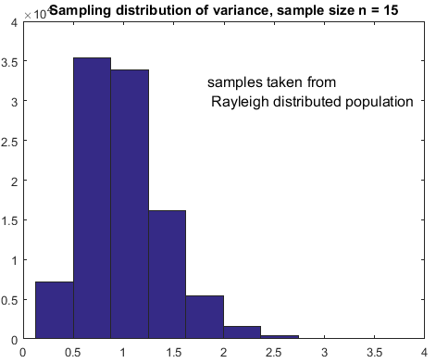
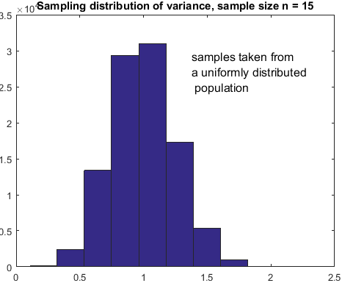
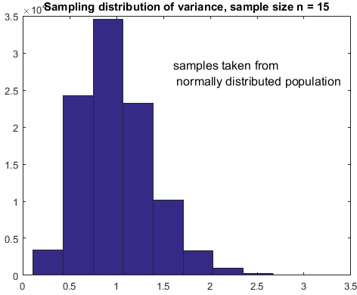
Hypothesis testing

Slide 115
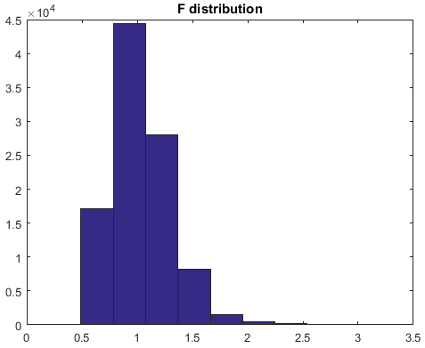
Hypothesis testing

Slide 116
Hypothesis testing
assumptions for F-test
need to check for approximate normality, unlike t-test
departure from normality --> reliability of results/analysis questionable
what to do if data is non-normal?

